Slide 1

Battle of the Neighbourhoods
Anand AL

Slide 2
Best Place to start Indian Restaurants

Slide 3
Introduction
This final project explores the best locations for Indian restaurants throughout the city of New York.
Food Business News stated that worldwide pasta sales were up for the second year in a row with the United Sates holding the largest market.
New York is a major metropolitan area with more than 8.4 million (Quick Facts, 2018) people living within city limits.
This report explores which neighbourhoods and boroughs of New York City have the most as well as the best Indian restaurants.
Additionally, I will attempt to answer the questions “Where should I open an Indian Restaurant?” and “Where should I stay If I want great Indian food?”

Slide 4
Data
In order to answer the above questions, data on New York City neighborhoods, boroughs to include boundaries, latitude, longitude, restaurants, and restaurant ratings and tips are required.
New York City data containing the neighborhoods and boroughs, latitudes, and longitudes will be obtained from the data source: https://cocl.us/new_york_dataset
New York City data containing neighborhood boundaries will be obtained from the data source: https://data.cityofnewyork.us/City-Government/Borough-Boundaries/tqmj-j8zm
All data related to locations and quality of Indian restaurants will be obtained via the FourSquare API utilized via the Request library in Python.

Slide 5
Methodology
• Data will be collected from https://cocl.us/new_york_dataset and cleaned and processed into a data frame.
• Foursquare be used to locate all venues and then filtered by Indian restaurants. Ratings, tips, and likes by users will be counted and added to the dataframe.
• Data will be sorted based on rankings
• Finally, the data be will be visually assessed using graphing from various Python libraries.

Slide 6
Problem Statement
What is / are the best location(s) for Indian cuisine in New York City?
In what Neighborhood and/or borough should I open an Indian restaurant to have the best chance of being successful?
Where would I go in New York City to have the best Indian food?

Slide 7
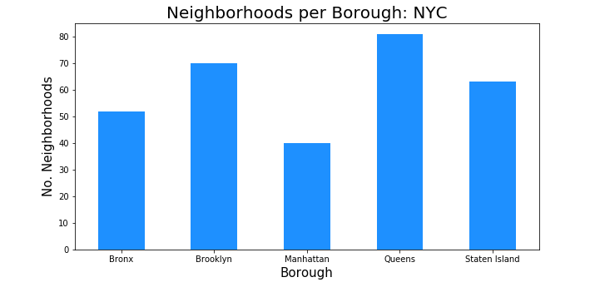
Neighborhood per Brough in New York

Slide 8
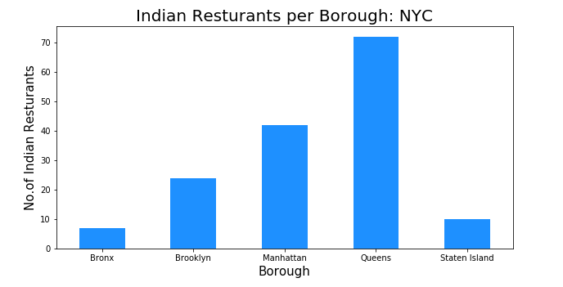
As we continue our analysis, we see below that although Manhattan had the least number of nieghborhoods, it does have the highest number if Indian restaurants. Additionally, we see how many restaurants the top 6 neighborhoods have. The neighborhood of Belmont has the highest number of Indian restaurants in all of NYC and is actually located in the burough of Bronx vice Manhattan.

Slide 9
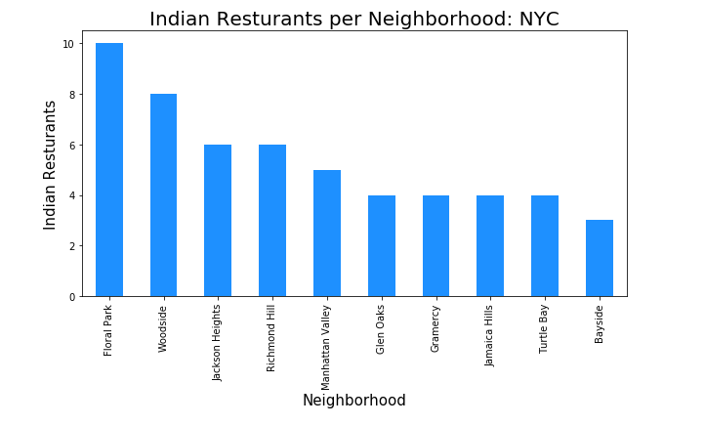
Top 6 Neighborhood with Indian Restarunt

Slide 10
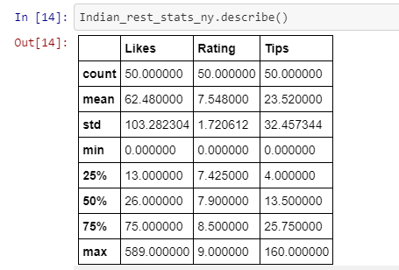
Indian Restaurant Ratings

Slide 11
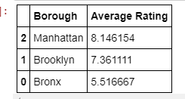
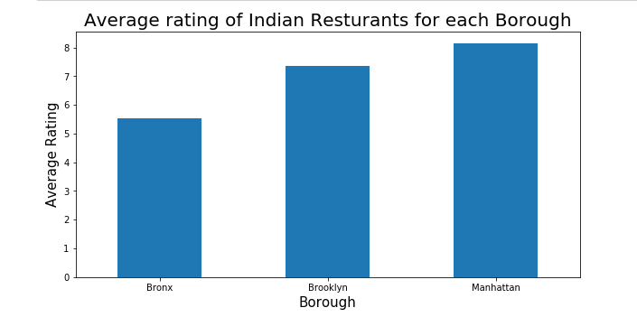
Avg. Rating on Borough

Slide 12
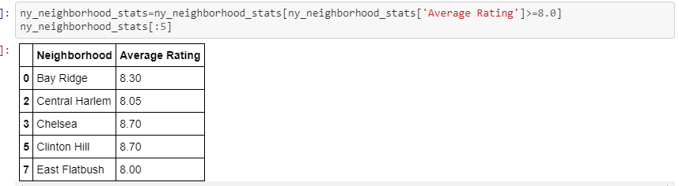
Restaurant with High Rating

Slide 13
Results / Conclusion
Manhattan and Brooklyn have the best rated Indian restaurants on average. Queens and The Bronx have the least amount of Indian restaurants per borough.
However, of note, Belmont of The Bronx is the neighbourhood in all of NYC with the most Indian Restaurants. Despite Manhattan having the least number of neighbourhoods in all five boroughs, it has the most Indian restaurants.
Based on this information, I would state that Manhattan and Brooklyn are the best locations for Indian cuisine in NYC.
To have the best shot of success, I would open an Indian restaurants in Brooklyn. Brooklyn has multiple neighbourhoods with average ratings exceeding 8 of a scale of 1.0 to 10.0 and has the least number of Indian restaurants making competition easier than in other boroughs.
As a final note, all of the above analysis is depended on the adequacy and accuracy of Four Square data. A more comprehensive analysis and future work would need to incorporate data from other external databases.

